Slide 1

Recognizing stages of Depression &
Optimizing through Guided Imagery
PROJECT SEMINAR
Session 2023-24
By
(G11)
Ms. Rishita Uikey
Ms. Arpita Mishra
Ms. Saloni Urade
Ms. Sakshi Deshmukh
Ms. Achal Akulwar
Guided By
Prof. Nikita P. Giradkar

Slide 2
Problem Definition
The objective of this project is to comprehensively understand and address the multifaceted stage posed by depression.
Depression is a complex mental health disorder that affects millions of individuals globally, leading to a range of negative impacts on their well-being, relationships, and overall quality of life.
By image or emotion, some common and general input with basic or rational and related Depression symptoms.
For normal or for college student showing symptoms we try to recover them and calm them by Guided Imagery.
those who have mild, moderate, severe and Extreme we will guide them to psychiatrist or medicator.
Notes:
2

Slide 3

Problem definition(contin…)
Stages of Depression
Normal or Depression symptoms
Mild depression
Moderate stage depression
Severe stage
Extreme stage

Slide 4

Problem definition(contin…)
The Symptoms Of Depression
Feeling sad, anxious or empty
Feeling hopeless of pessimistic
Feeling guilty, worthless or helpless
Not enjoying things
Trouble in concentration, memory
Gaining or losing weight
Feeling restless or irritable
Hypersomnia or insomnia
Thoughts of suicide or death

Slide 5
Abstract
This project focuses on exploring the feasibility of identifying depression and stage of depression through the analysis of human biometric data. Depression is a widespread mental health disorder that often goes undetected due to stigma and lack of accurate diagnostic methods.
Leveraging advancements in biometric sensing technologies, this study aims to develop a novel approach for early detection of depression by analyzing physiological signals such as facial expressions, behavior, introspection.
Machine learning algorithms will be employed to extract meaningful patterns from the biometric data, establishing a reliable model for depression identification. Successful implementation of this method could lead to non-intrusive, cost-effective, and timely detection of depression, thereby facilitating early intervention and improved mental health outcomes.

Slide 6
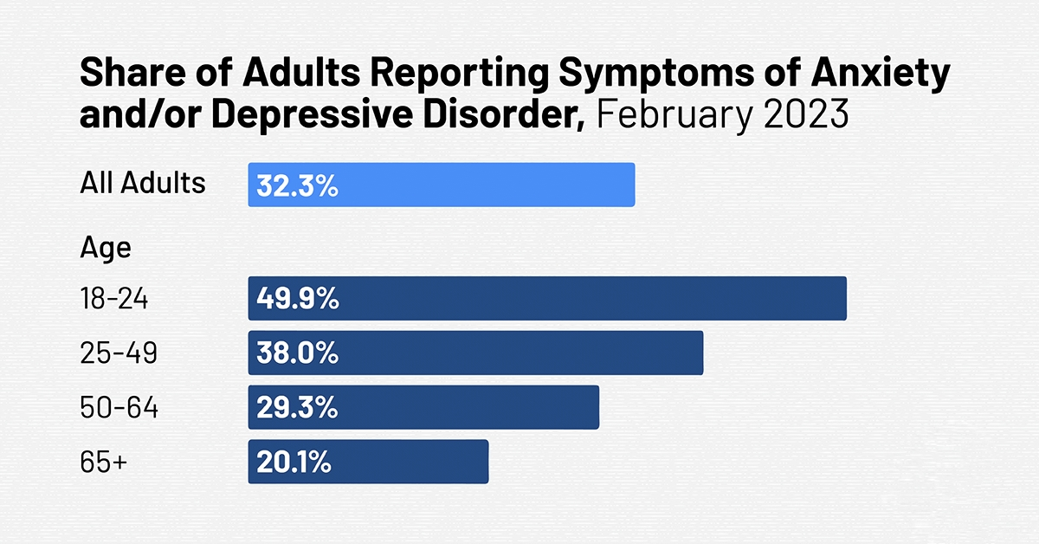
Objectives
Early Detection and Awareness
Accurate Identification of Stages
Guided Imagery Techniques and Resources
Integration into Treatment Plans
Public Outreach and Education
Long-term Monitoring and Support
Ethical Considerations
Notes:
6

Slide 7
Literature Survey
Sr no. | Title Of the Paper | Author | Major Observations/Findings
1. | Depression detection using emotional artificial intelligence and machine learning:A closer review(2022) | Manju Lata Joshi a, Nehal Kanoongo b | This study analyses how facial expressions, images,emotional chat_x0002_bots and texts on social media platforms can effectively detect one’s emotions and then depression. Naïve-Bayes,support vector machines,Long term short memory-Radial neural networks,logistic regression,linear support vector are various ML techniques used to recognize emotions from text processing. Artificial neural network is used for feature extraction. Classification of images to detect emotions through facial expressions.
2. | Deep Learning for depression detection from Textual Data(2022) | Amma Amanat 1,Muhammad Rizwan 1,*,Abdul Rehman Javed 2,Maha Abdelhaq 3,Raed Alsaqpour, Sharmil Pandya ,Mueen Uddin 6 | Productive model by implementing long short term memory model, consisting of two hidden layers.Large bias with Recurrent Neural Network with two dense layers. Train RNN on textual data to identify depression from text, semantics, written content.
3. | Machine Learning Algorithms for Depression : Diagnosis, Insights and Research Directions(2022) | Shumaila Aleem, Noor ul Huda, Rashid Amin,*,Samina Khalid, Sultan S. Alshamrani, Abdullah Alshchri | General model diag_x0002_nosis involving data extraction, pre-processing, training ML classifier, detection classification, performance evaluation. Identify Objectives, limitations of different research studies presented in the domain.
4. | Depression Detection using Machine learning techniques(2021) | Kuhaneswaran A/I,Govindasamy,Naveen Palanichamy | Twitter data is fed into different type of classifier i.e. Naive Bayes and Hybrid model,NBTree.
Notes:
7

Slide 8
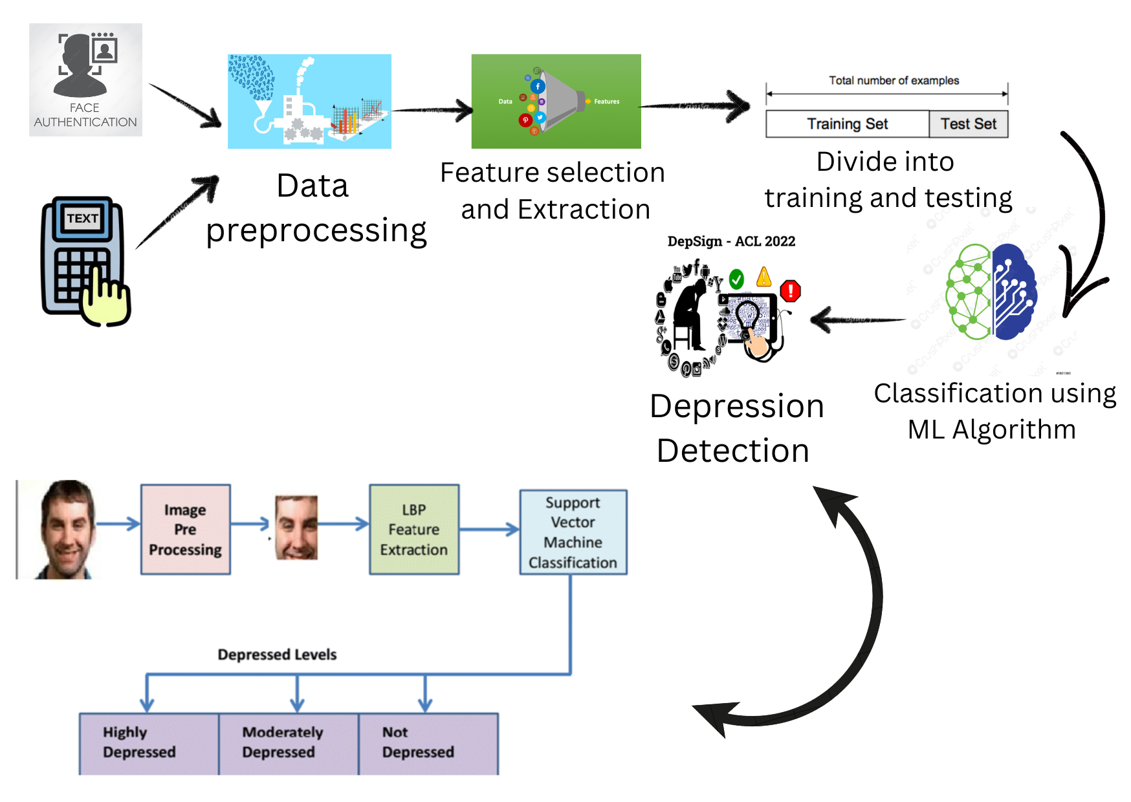
Plan of Action
Notes:
8

Slide 9
Hardware and Software Requirement
Hardware Requirements
Biometric Sensors
Data Collection Devices
Storage
Camera
Speaker
Software Requirements
Python
MySQL
Notes:
9

Slide 10
References
Kuhaneswaran A/L Govindasamy et al, Depression Detection Using Machine Learning Techniques on Twitter Data. ©2021 IEEE
Nafiz Al Asad et al. Depression Detection by Analyzing Social Media Posts of User. In 2019 IEEE
Zhiyong wang et al. Recognition of Audio Depression Based on Convolutional Neural Network and Generative Antagonism Network Model. Digital Object Identifier 10.1109/ACCESS.2020.2998532 IEEE
Hanadi Solieman et al. The Detection of Depression Using Multimodal Models Based on Text and Voice Quality Features. In 2021 IEEE
Yan Ding et al. A Depression Recognition Method For College Students Using Deep Integrated Support Vector Algorithm. Published In 2020 IEEE
Young-Shin Lee 1 and Won-Hyung Park 2, Diagnosis of Depressive Disorder Model on Facial Expression Based on Fast RCNN, Diagnostics 2022, 12, 317
Guo, W et al. “Deep neural networks for depression recognition based on facial expressions caused by stimulus tasks,” in 2019 IEEE )
Melo, W. C. D., Granger, E., and Hadid, A. (2019). “Combining global and local convolutional 3d networks for detecting depression from facial expressions,” in 2019 14th IEEE
Pampouchidou, et al.Automatic assessment of depression based on visual cues: a systematic review. IEEE
Zhou et al. Visually interpretable representation learning for depression recognition from facial images. 2020 IEEE Trans.
Notes:
10

Slide 11
Thank You…….

